Slide 1

Web Application Firewall Using Machine Learning
Name: Sairin Sayyed Abdul Hamid
Seat No. : 40081

Slide 2
Introduction
Web application firewall helps protect web applications by filtering and monitoring HTTP traffic between a web application and the Internet.
A Web Application Firewall (WAF) is necessary to enhance the security and protect web applications from various cyber threats.
In this project, I have made a model that learned underlying patterns from the dataset and classify whether the query is clean or malicious on unseen data

Slide 3
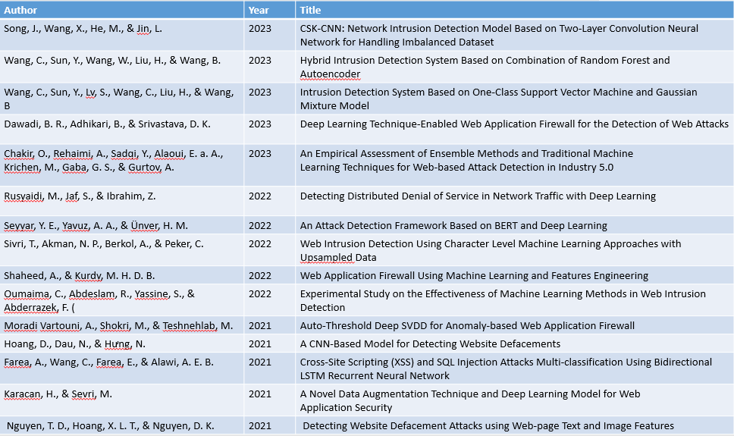
Literature Review
[30] papers are cited of which 15 are shown below:
Conclusion:
Paper referred are from year [2023-2019]
The most commonly technique used was to detect the attacks and type of attacks and have accuracy rate of 95% - 97%

Slide 4

Materials and Methods:
Proposed Model(Diagrammatic Representation):
Logistic Regression
Evaluate the model
Preprocessing the Dataset
Training the
Model
Best Model
Random Forest Classifier
Evaluate the model
Dataset
Classification of request in unseen data

Slide 5
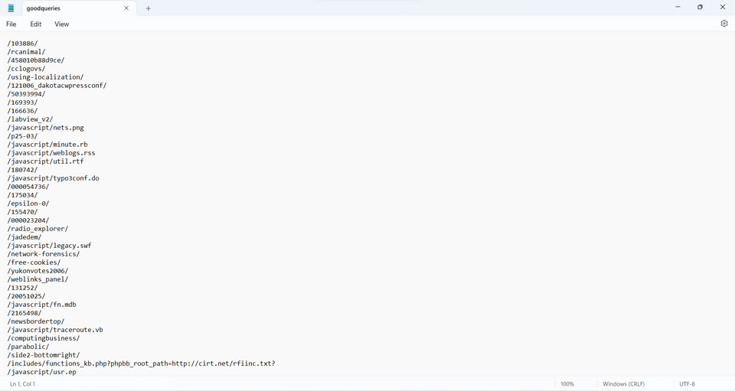
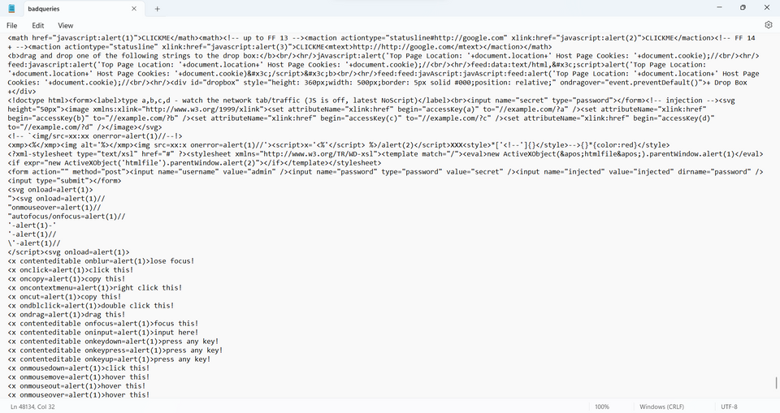
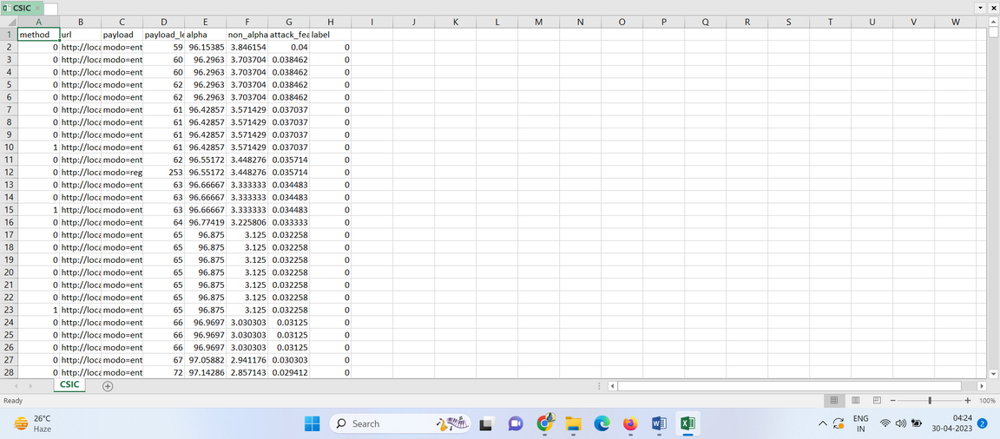
Datasets:
Data Source: Github
Query Dataset:
CSIC(Corpus of Web-Based Malware
Scenarios and Initial Classification)
Dataset:

Slide 6
Classifier Used:
Logistic Regression:
Logistic regression is an example of supervised learning. It is used to calculate or predict the probability of a binary (yes/no) event occurring
Random Forest Classifier:
Random Forest is a supervised machine learning algorithm made up of decision trees. Random Forest is used for both classification and regression.A random forest classifier works with data having discrete labels or better known as class.

Slide 7
Evaluation Of Model:
1. Accuracy: a prediction's accuracy is determined by how many of the total forecasts were correct. The ratio of total correct predictions to total predictions is used to compute it. It refers to the proportion of samples in the test set that were correctly categorised in this instance.
2. Precision: estimates the percentage of samples projected to be positive (including true positives and false positives) that are actually positive (properly categorised harmful samples). It is determined by taking the ratio of genuine positives to the total of both true and false positives.
3. Recall: calculates the ratio of true positives to all actual positives (including true positives and false negatives). As the total of true positives and false negatives divided by the ratio of true positives, it is calculated.
4. The F1-score: It represents the harmonic mean of recall and precision. It offers a mix between recall and precision. As 2 * (precision * recall) / (precision + recall), it is calculated.

Slide 8

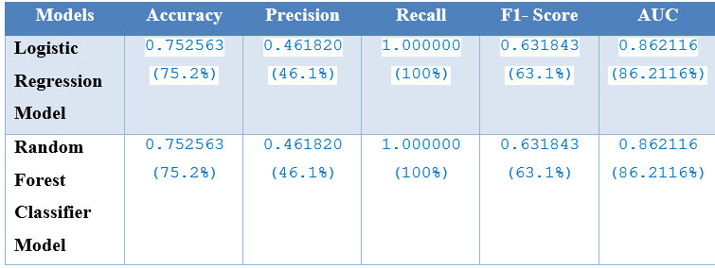
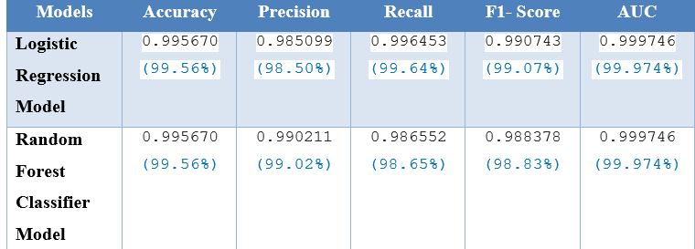
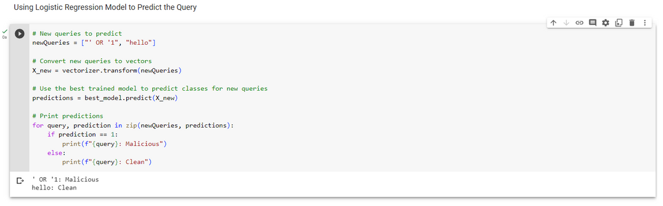
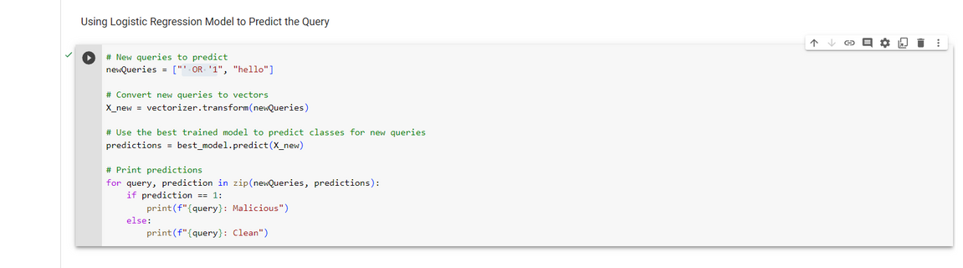
Results and Analysis:
CSIC Dataset:
Query Dataset:
The Logistic Regression Model has the high accuracy
The Logistic Regression Model was chosen for further classifying the queries as either clean or malicious. The model worked well in classifying the queries. It has predicted the clean query as clean and malicious queries as malicious for SQL payload.
The RandomForestClassifier Model has the high accuracy
The RandomForestClassifier Model was chosen for further classifying the URL as either clean or malicious. The model worked well in classifying the queries. It has predicted the clean query as clean and malicious queries as malicious for SQL payload.

Slide 9
Conclusion:
The Model learned the underlying pattern and characteristics successfully on query dataset and CSIC Dataset and can classify between malicious and clean query on unseen data.

Slide 10
Future Work:
Expanding the dataset
Upgrades to feature engineering
Online learning
Try out different classifiers

Slide 11
1.Song, J., Wang, X., He, M., & Jin, L. (2023b). CSK-CNN: Network Intrusion Detection Model Based on Two-Layer Convolution Neural Network for Handling Imbalanced Dataset. Information, 14(2), 130. https://doi.org/10.3390/info14020130
2.Wang, C., Sun, Y., Wang, W., Liu, H., & Wang, B. (2023). Hybrid Intrusion Detection System Based on Combination of Random Forest and Autoencoder. Symmetry, 15(3), 568. https://doi.org/10.3390/sym1503056
3.Wang, C., Sun, Y., Lv, S., Wang, C., Liu, H., & Wang, B. (2023). Intrusion Detection System Based on One-Class Support Vector Machine and Gaussian Mixture Model. Electronics, 12(4), 930. https://doi.org/10.3390/electronics12040930
4.Dawadi, B. R., Adhikari, B., & Srivastava, D. K. (2023). Deep Learning Technique-Enabled Web Application Firewall for the Detection of Web Attacks. Sensors, 23(4), 2073. https://doi.org/10.3390/s23042073
5.Chakir, O., Rehaimi, A., Sadqi, Y., Alaoui, E. a. A., Krichen, M., Gaba, G. S., & Gurtov, A. (2023). An empirical assessment of ensemble methods and traditional machine learning techniques for web-based attack detection in industry 5.0. Journal of King Saud University - Computer and Information Sciences, 35(3), 103–119. https://doi.org/10.1016/j.jksuci.2023.02.009
References:

